Slide 1
Analysis & Design of Algorithm

Slide 2
Introduction to Algorithm
Algorithm Definition and its properties
Requirement to study algorithm
Algorithm vs. Program
Algorithm design techniques
Asymptotic Notations and their properties
Recurrence relation
Fundamentals of the Analysis of Algorithmic Efficiency
Time and Space complexity analysis of Recursive and Non-recursive algorithms.

Slide 3
Let’s Begin
Let’s play a guessing game.
Following are the rules
You need to guess a number between 1 and 100
Based on your guess, the computer will tell you if your guess is high or low
You will get 5 chances to guess the correct number
Link: https://scratch.mit.edu/projects/61353942

Slide 4
So how would you define an algorithm?
Based on the previous activity, an algorithm would be a step-by-step process to solve a problem.
The dictionary meaning states:
algorithm (noun) : a set of steps to accomplish a task.
You could say: the initial approach of guessing numbers one after another is an algorithm. Similarly, the second approach we observed is another algorithm.

Slide 5
Formally
An algorithm is a set of commands that must be followed for a computer to perform calculations or other problem-solving operations.
According to its formal definition, an algorithm is a finite set of instructions carried out in a specific order to perform a particular task.
It is not the entire program or code; it is simple logic to a problem represented as an informal description in the form of a flowchart or pseudocode.

Slide 6
Can you identify an algorithm from normal text?
Look and observe the following two texts:
The algorithm helps you to find the product of numbers.
or
The algorithm helps you to find the product of two 4-bit binary numbers.
What characteristic are we talking about?

Slide 7
Input
The second statement talks about what will be input to the algorithm.
An algorithm requires some input values. An algorithm should have 0 or more well-defined inputs.

Slide 8
What about following?
Look and observe the following two texts:
The algorithm inputs two 4-bit numbers.
or
The algorithm helps you to find the product of two 4-bit binary numbers.
What characteristic are we talking about?

Slide 9
Output
The second statement again talks about what will be the outcome of the steps we are following.
At the end of an algorithm, you will have one or more outcomes.
An algorithm should have 1 or more well-defined outputs, and should match the desired output.

Slide 10
Other Characteristics
Unambiguity: A perfect algorithm is defined as unambiguous, which means that its instructions should be clear and straightforward.
Shift the result of the operation right.
or
Arithmetic shift right the result of the operation.
Finiteness: An algorithm must be finite. Finiteness in this context means that the algorithm should have a limited number of instructions, i.e., the instructions should be countable.
If SC = 0, Then stop.

Slide 11
Contd.
Effectiveness: Because each instruction in an algorithm affects the overall process, it should be adequate. For an algorithm to be effective, it means that all those steps that are required to get to output must be feasible with the available resources. It should not contain any unnecessary and redundant steps which could make an algorithm ineffective.
Language independence: An algorithm must be language-independent, which means that its instructions can be implemented in any language and produce the same results.

Slide 12
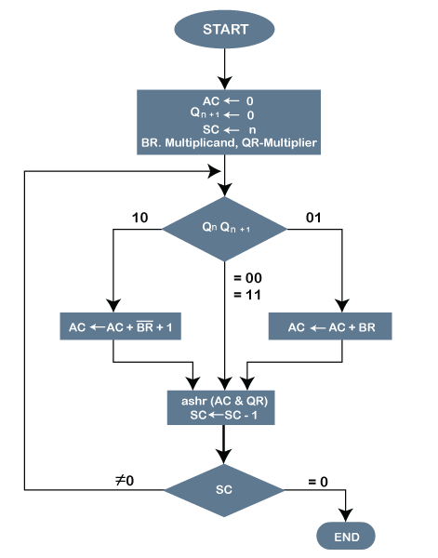
Example

Slide 13
Why study ADA?
Computer scientists learn by experience. We learn by seeing others solve problems and by solving problems by ourselves.
Being exposed to different problem-solving techniques and seeing how different algorithms are designed helps us to take on the next challenging problem that we are given.
By considering a number of different algorithms, we can begin to develop pattern recognition so that the next time a similar problem arises, we are better able to solve it.

Slide 14
Another Aspect
As we study algorithms, we can learn analysis techniques that allow us to compare and contrast solutions based solely on their own characteristics, not the characteristics of the program or computer used to implement them.

Slide 15
Algorithm vs Pseudocode vs Program
Algorithm – It is a well-defined, systematic logical approach that comes with a step-by-step procedure for computers to solve any given program.
Pseudocode – A pseudocode is basically a simplified version of the programming codes. These codes exist in the plain English language, and it makes use of various short phrases for writing a program code before implementing it in any programming language.
Program – It refers to the code (written by programmers) for any program that follows the basic rules of the concerned programming language.

Slide 16
Contd.
Parameters | Algorithm | Program | Pseudocode
Meaning and Definition | An algorithm is a well-defined, systematic logical approach that comes with a step-by-step procedure for computers to solve any given program. | It refers to the code (written by programmers) for any program that follows the basic rules of the concerned programming language. | It is basically a simplified version of the programming codes. These codes exist in the plain English language, and it makes use of various short phrases for writing a program code before implementing it in any programming language.

Slide 17
Contd.
Parameters | Algorithm | Program | Pseudocode
Expression and Use | We can express algorithms using flowcharts, natural language, and many more. | No device can directly read a program. Instead, you can write anything in a computer language and then use a compiler or interpreter (for compiling and interpreting) so that it becomes understandable for any computer system. | You get to include various control structures using pseudocode, such as repeat-until, if-then-else, while, for and case.

Slide 18
Algorithm: Linear Search
1. Start from the leftmost element of arr[] and one by one compare x with each element of arr[].
2. If x matches with an element, return the index.
3. If x doesn’t match with any of elements, return -1.

Slide 19
Pseudocode
FUNCTION linearSearch(list, searchTerm):
FOR index FROM 0 -> length(list):
IF list[index] == searchTerm THEN
RETURN index
ENDIF
ENDLOOP
RETURN -1
END FUNCTION

Slide 20
Code
# Python3 code for linearly search x in arr. If x
# is present then return its location, otherwise
# return -1
def search( arr, n, x):
for i in range(n):
if (arr[i] == x):
return i
return -1

Slide 21
Algorithm Design Techniques
Brute-force or exhaustive search
Divide and Conquer
Greedy Algorithms
Dynamic Programming
Branch and Bound Algorithm
Randomized Algorithm
Backtracking

Slide 22
Brute-force or exhaustive search
Have a look at this problem.
result = input % random_num
Random_num has value 10.
Result has value 5.
What is the input?

Slide 23
Brute-force or exhaustive search
Have a look at this problem.
result = input % random_num
Input ranges from 1 to 100.
Random_num has value 10.
Result has value 5.
What is the input?

Slide 24
Divide and Conquer
The Fake Coin
You are given n coins. They all look identical. They should all be the same weight, too -- but one is a fake, made of a lighter metal.
Your neighbour has an old-fashioned balance scale that enables you to compare any two sets of coins. If it tips either to the left or to the right, you will know that the one of the sets is heavier than the other. Sadly, you aren't on speaking terms with the neighbour, so he charges you each time you weigh anything.
Your task is this:
Design an algorithm to find the fake coin in the fewest number of weighing's.
How many times must you use the scale?

Slide 25
Divide and Conquer

Slide 26
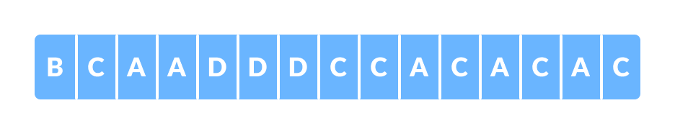
Greedy Algorithm
The number of bits required to transfer the following data:

Slide 27
Greedy Algorithm
The number of bits required to transfer the following data:
Each character is of 8 bits. There are 15 characters. So, total 8 * 15 = 120 bits.
Can we do something better? Is there a technique which can reduce the size of input text?

Slide 28
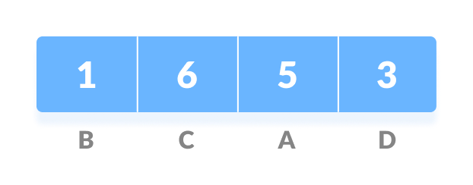
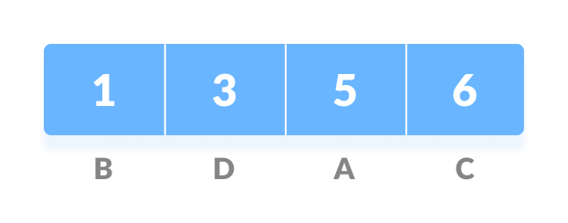
Encoding
Calculate the frequency:
Sort the result:

Slide 29
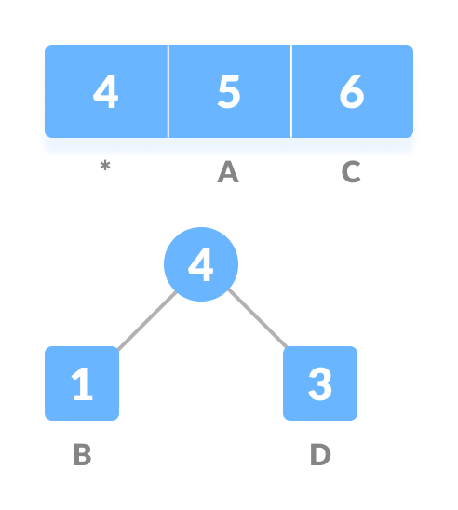
Contd.
Select two nodes with minimum frequency. Create a new temporary node with sum of frequency. Remove the two nodes from the list.

Slide 30
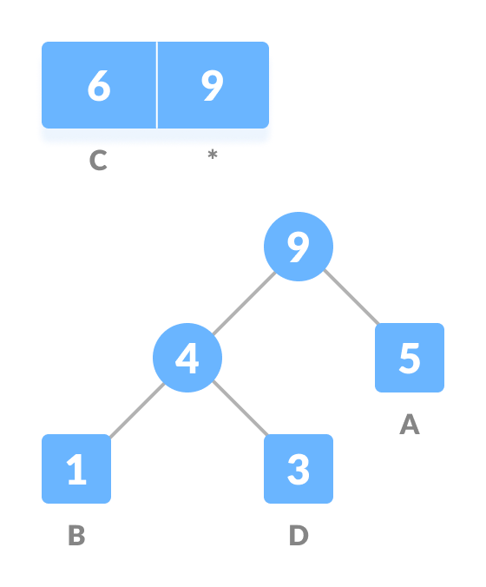
Repeat the above steps

Slide 31
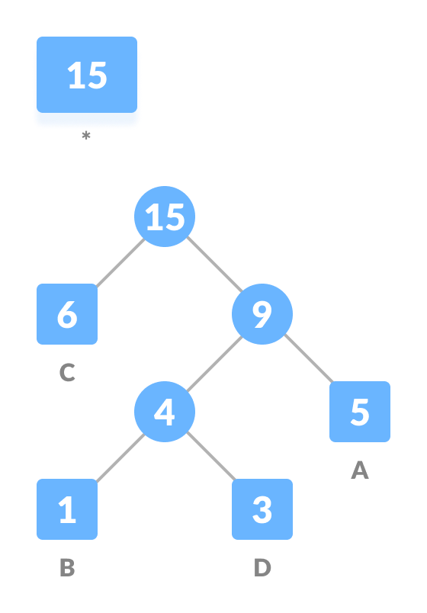
Contd.

Slide 32
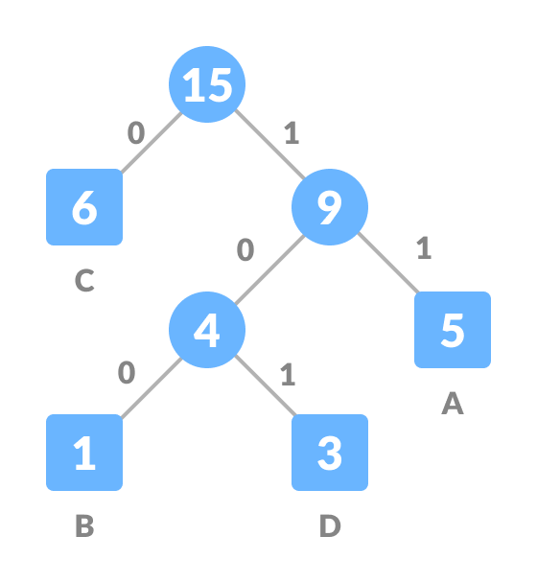
Contd.

Slide 33
Size after encoding
Character | Frequency | Code | Size
A | 5 | 11 | 5*2 = 10
B | 1 | 100 | 1*3 = 3
C | 6 | 0 | 6*1 = 6
D | 3 | 101 | 3*3 = 9
4 * 8 = 32 bits | 15 bits |  | 28 bits
Without encoding, the total size of the string was 120 bits. After encoding the size is reduced to 32 + 15 + 28 = 75 bits

Slide 34

Decoding
101 will be decoded to?

Slide 35
Dynamic Programming
It improves the efficiency of the algorithm by storing intermediate results. It goes through five steps to find the best solution to the problem:
1. It divides the problem into subproblems to find the best solution.
2. After breaking down the problem into subproblems, it finds the best solution from these subproblems.
3. Memorization is the process of storing the results of subproblems.
4. Reuse the result to prevent it from being recomputed for the same subproblems.
5. Finally, it computes the complex program's output.

Slide 36
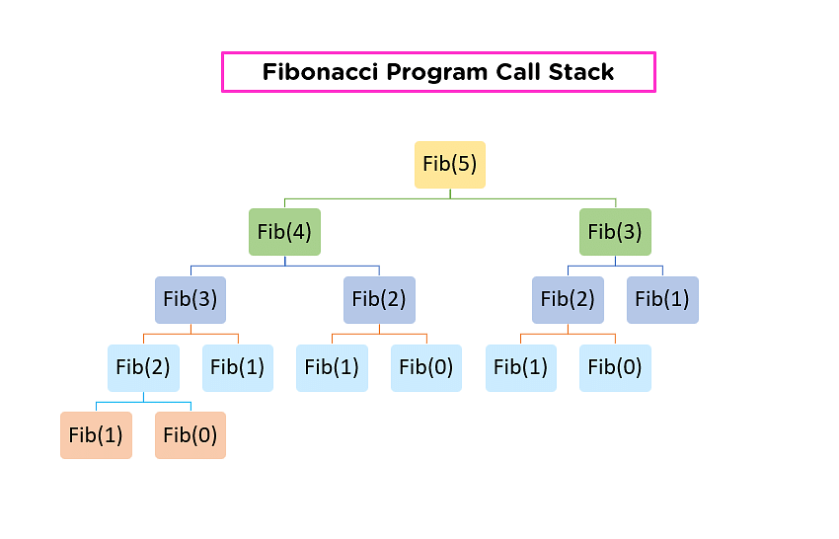
Problem

Slide 37
Branch and Bound
Given a 3×3 board with 8 tiles (every tile has one number from 1 to 8) and one empty space. The objective is to place the numbers on tiles to match the final configuration using the empty space. We can slide four adjacent (left, right, above, and below) tiles into the empty space.
Initial State Final State
1
2
3
1
2
3
5
6
5
8
6
7
8
4
7
4

Slide 38
Approach
There are basically three types of nodes involved in Branch and Bound
1. Live node is a node that has been generated but whose children have not yet been generated.
2. E-node is a live node whose children are currently being explored. In other words, an E-node is a node currently being expanded.
3. Dead node is a generated node that is not to be expanded or explored any further. All children of a dead node have already been expanded.

Slide 39
Formula
c(x) = f(x) + g(x)
c(x) : lower bound cost of node ‘x’
f(x) : length of the path from root node to node ‘x’
g(x) : number of non-blank tiles which are not in their goal position

Slide 40
Solution
1
2
3
This becomes the root node. Calculating the cost :
c(x) = 0 + 3 = 3 because 6, 7, and 8 are not in their position as per solution.
5
6
7
8
4

Slide 41
Solution
1
2
3
1
2
3
1
2
3
5
6
5
6
5
8
6
7
8
4
7
8
4
7
4
1
2
3
5
8
6
7
4

Slide 42
Randomized Algorithm
An algorithm that uses random numbers to decide what to do next anywhere in its logic is called a Randomized Algorithm.
For example, in Karger’s algorithm for minimum cut, we use random edge to remove it and combine two vertices.

Slide 43
Algorithm
1) Initialize contracted graph CG as copy of original graph
2) While there are more than 2 vertices.
a) Pick a random edge (u, v) in the contracted graph.
b) Merge (or contract) u and v into a single vertex (update
the contracted graph).
c) Remove self-loops
3) Return cut represented by two vertices.

Slide 44
Example
0
a
1
b
c
d
2
3
e

Slide 45
Merge link “a”: a random selection
0,1
b
c
d
2
3
e

Slide 46
Merge link “d”: a random selection
c
b
2
0,13
e

Slide 47
Remove self-loop
b
2
0,13
e

Slide 48
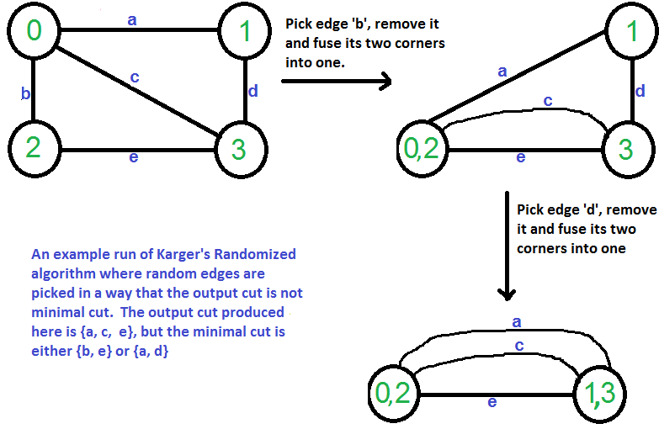
Will you always get optimal result?

Slide 49
Backtracking
Backtracking is an algorithmic technique for solving problems recursively by trying to build a solution incrementally, one piece at a time, removing those solutions that fail to satisfy the constraints of the problem at any point in time (by time, here, is referred to the time elapsed till reaching any level of the search tree).
Backtracking can also be said as an improvement to the brute force approach.

Slide 50
4 Queen Problem
How to set 4 queens on a 4x4 chessboard without the queens attacking each other?

Slide 51
Difference
Parameter | Backtracking | Branch and Bound
Approach | Backtracking is used to find all possible solutions available to a problem. When it realises that it has made a bad choice, it undoes the last choice by backing it up. It searches the state space tree until it has found a solution for the problem. | Branch-and-Bound is used to solve optimisation problems. When it realises that it already has a better optimal solution that the pre-solution leads to, it abandons that pre-solution. It completely searches the state space tree to get optimal solution.
Traversal | Backtracking traverses the state space tree by DFS(Depth First Search) manner. | Branch-and-Bound traverse the tree in any manner, DFS or BFS.
Function | Backtracking involves feasibility function. | Branch-and-Bound involves a bounding function.

Slide 52
Python Code
# Import time module
import time
# record start time
start = time.time()
# define a sample code segment
a = 0
for i in range(1000):
a += (i**100)
# record end time
end = time.time()
# print the difference between start
# and end time in milli. secs
print("The time of execution of above program is :",
(end-start) * 10**3, "ms")

Slide 53
Asymptotic Analysis
In Asymptotic Analysis, we evaluate the performance of an algorithm in terms of input size (we don’t measure the actual running time).
We calculate, how the time (or space) taken by an algorithm increases with the input size.

Slide 54
Why?
There are many important things that should be taken care of, like user-friendliness, modularity, security, maintainability, etc. Why worry about performance?
The answer to this is simple, we can have all the above things only if we have performance.
So, performance is like currency through which we can buy all the above things.

Slide 55
Why not?
Asymptotic Analysis is not perfect, but that’s the best way available for analysing algorithms.
For example, say there are two sorting algorithms that take 1000nLogn and 2nLogn time respectively on a machine. Both of these algorithms are asymptotically the same (order of growth is nLogn).
So, With Asymptotic Analysis, we can’t judge which one is better as we ignore constants in Asymptotic Analysis.

Slide 56
Notations
The main idea of asymptotic analysis is to have a measure of the efficiency of algorithms that don’t depend on machine-specific constants and don’t require algorithms to be implemented and time taken by programs to be compared.
Asymptotic notations are mathematical tools to represent the time complexity of algorithms for asymptotic analysis.

Slide 57
Contd.
There are mainly three asymptotic notations:
1. Big-O Notation (O-notation)
2. Omega Notation (Ω-notation)
3. Theta Notation (Θ-notation)

Slide 58
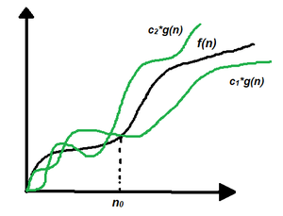
Theta Notation
Theta notation encloses the function from above and below. Since it represents the upper and the lower bound of the running time of an algorithm, it is used for analysing the average-case complexity of an algorithm.
Θ (g(n)) = {f(n): there exist positive constants c1, c2 and n0 such that 0 ≤ c1 * g(n) ≤ f(n) ≤ c2 * g(n) for all n ≥ n0}
Note: Θ(g) is a set

Slide 59
Big-O Notation
Big-O notation represents the upper bound of the running time of an algorithm. Therefore, it gives the worst-case complexity of an algorithm.
O(g(n)) = { f(n): there exist positive constants c and n0 such that 0 ≤ f(n) ≤ cg(n) for all n ≥ n0 }

Slide 60
Omega Notation
Omega notation represents the lower bound of the running time of an algorithm. Thus, it provides the best case complexity of an algorithm.
Ω(g(n)) = { f(n): there exist positive constants c and n0 such that 0 ≤ cg(n) ≤ f(n) for all n ≥ n0 }

Slide 61
Linear Search: Example
#include <stdio.h>
int search(int arr[], int size, int x) {
int i=0;
for (i=0; i<size; i++)
if (arr[i] == x)
return i;
return -1;
}
int main() {
int arr[] = {2,3,1,5};
int size = sizeof(arr) / sizeof(arr[0]);
int find = 1;
printf("Position of %d is %d\n", find, search(arr,size,find));
return 0;
}

Slide 62
Worst Case
The worst case will take place if:
1. The element to be search is in the last index
2. The element to be search is not present in the list
In both cases, the maximum number of comparisons take place in Linear Search which is equal to N comparisons.
Hence, the Worst Case Time Complexity of Linear Search is O(N).

Slide 63
Best Case
The Best Case will take place if: The element to be search is on the first index.
The number of comparisons in this case is 1. Therefore, Best Case Time Complexity of Linear Search is O(1).

Slide 64
Average Case
Let there be N distinct numbers: a1, a2, ..., a(N-1), aN.
We need to find element P.
There are two cases:
Case 1: The element P can be in N distinct indexes from 0 to N-1.
Case 2: There will be a case when the element P is not present in the list.
There are N case 1 and 1 case 2. So, there are N+1 distinct cases to consider in total.

Slide 65
Average Case: Contd.
If element P is in index K, then Linear Search will do K+1 comparisons.
Number of comparisons for all cases in case 1 = Comparisons if element is in index 0 + Comparisons if element is in index 1 + ... + Comparisons if element is in index N-1 = 1 + 2 + ... + N = N * (N+1) / 2 comparisons
If element P is not in the list, then Linear Search will do N comparisons.
Number of comparisons for all cases in case 2 = N
Therefore, total number of comparisons for all N+1 cases = N * (N+1) / 2 + N
= N * ((N+1)/2 + 1)
Average number of comparisons = ( N * ((N+1)/2 + 1) ) / (N+1)
= N/2 + N/(N+1)

Slide 66





Recursive Algorithm
The process in which a function calls itself directly or indirectly is called recursion and the corresponding function is called a recursive function.

Slide 67
Contd.
A recursive function solves a particular problem by calling a copy of itself and solving smaller subproblems of the original problems.
Many more recursive calls can be generated as and when required.
It is essential to know that we should provide a certain case in order to terminate this recursion process.

Slide 68
Why?
Reduce the length of code
Make it easier to read and write.
Point to remember: A task that can be defined with its similar subtask, recursion is one of the best solutions for it. For example; The Factorial of a number.

Slide 69
Cases
There are two types of cases in recursion:
recursive case
base case.
Factorial(5) = 5 * Factorial(4): Recursive case
Factorial(1) = 1: Base case

Slide 70
Fibonacci Series
def fib(n):
# Stop condition
if (n == 0):
return 0
# Stop condition
if (n == 1 or n == 2):
return 1
# Recursion function
else:
return (fib(n - 1) + fib(n - 2))
n = 5;
print("Fibonacci series of 5 numbers is :",end=" ")
for i in range(0,n):
print(fib(i),end=" ")

Slide 71
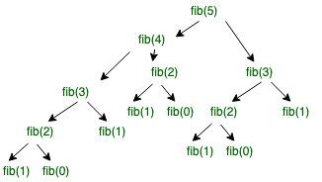
Working

Slide 72
Recurrence Relation
A recurrence relation is an equation which represents a sequence based on some rule.
It helps in finding the subsequent term (next term) dependent upon the preceding term (previous term).
If we know the previous term in a given series, then we can easily determine the next term.

Slide 73
Example
Base Case:
n if n == 0, n == 1;
Meaning T(0) = 0, T(1) = 1
Recursive Case:
fib(n) = fib(n-1) + fib(n-2) otherwise;
Meaning T(n) = T(n-1) + T(n-2) + 1

Slide 74
Solving Recurrence Relation
T(n) = T(n-1) + T(n-2) + 1
Assuming T(n-1) ≈ T(n-2)
T(n) = 2 * T(n-1) + 1
Solving it we get
T(n) = O(2^n)

Slide 75
Space Complexity
The space complexity for Fibonacci series is O(n). Let us look at process stack.

